Slide 1
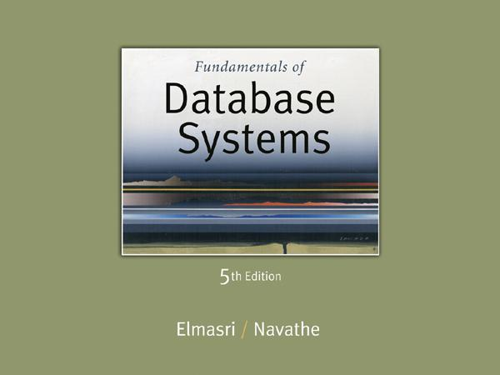
Slide 4- 1
Notes:
1

Slide 2
Chapter 4
Enhanced Entity-Relationship (EER) Modeling
Copyright © 2007 Ramez Elmasri and Shamkant B. Navathe
Notes:
2

Slide 3
Chapter Outline
EER stands for Enhanced ER or Extended ER
EER Model Concepts
Includes all modeling concepts of basic ER
Additional concepts:
subclasses/superclasses
specialization/generalization
categories (UNION types)
attribute and relationship inheritance
These are fundamental to conceptual modeling
The additional EER concepts are used to model applications more completely and more accurately
EER includes some object-oriented concepts, such as inheritance
Slide 4- 3
Notes:
3

Slide 4
Subclasses and Superclasses (1)
An entity type may have additional meaningful subgroupings of its entities
Example: EMPLOYEE may be further grouped into:
SECRETARY, ENGINEER, TECHNICIAN, …
Based on the EMPLOYEE’s Job
MANAGER
EMPLOYEEs who are managers
SALARIED_EMPLOYEE, HOURLY_EMPLOYEE
Based on the EMPLOYEE’s method of pay
EER diagrams extend ER diagrams to represent these additional subgroupings, called subclasses or subtypes
Slide 4- 4
Notes:
4

Slide 5
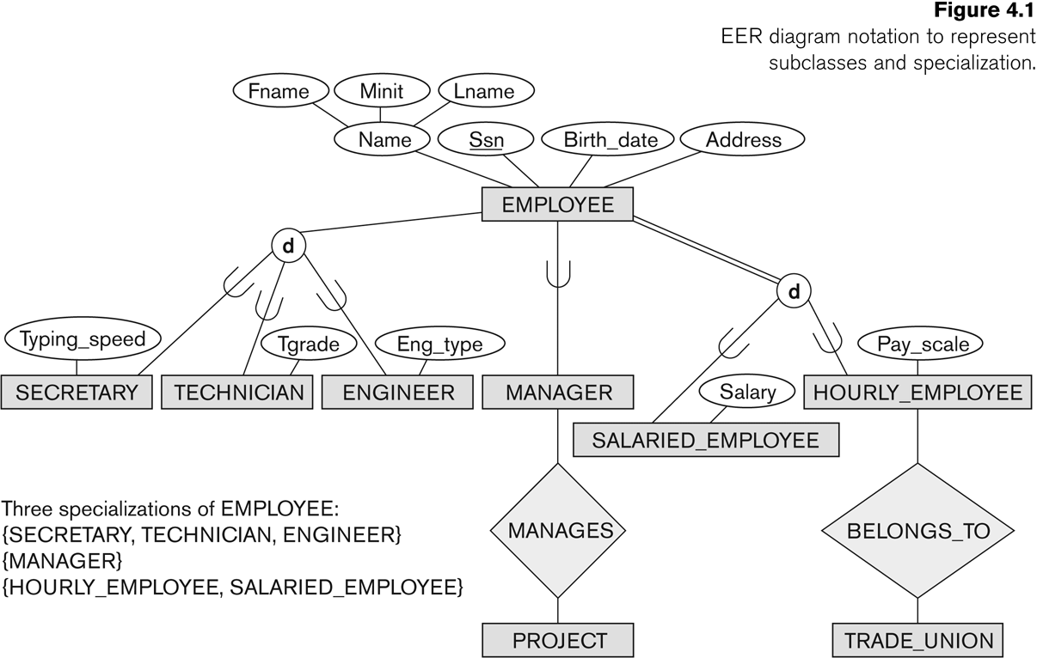
Subclasses and Superclasses
Slide 4- 5
Notes:
5

Slide 6
Subclasses and Superclasses (2)
Each of these subgroupings is a subset of EMPLOYEE entities
Each is called a subclass of EMPLOYEE
EMPLOYEE is the superclass for each of these subclasses
These are called superclass/subclass relationships:
EMPLOYEE/SECRETARY
EMPLOYEE/TECHNICIAN
EMPLOYEE/MANAGER
…
Slide 4- 6
Notes:
6

Slide 7
Subclasses and Superclasses (3)
These are also called IS-A relationships
SECRETARY IS-A EMPLOYEE, TECHNICIAN IS-A EMPLOYEE, ….
Note: An entity that is member of a subclass represents the same real-world entity as some member of the superclass:
The subclass member is the same entity in a distinct specific role
An entity cannot exist in the database merely by being a member of a subclass; it must also be a member of the superclass
A member of the superclass can be optionally included as a member of any number of its subclasses
Slide 4- 7
Notes:
7

Slide 8
Subclasses and Superclasses (4)
Examples:
A salaried employee who is also an engineer belongs to the two subclasses:
ENGINEER, and
SALARIED_EMPLOYEE
A salaried employee who is also an engineering manager belongs to the three subclasses:
MANAGER,
ENGINEER, and
SALARIED_EMPLOYEE
It is not necessary that every entity in a superclass be a member of some subclass
Slide 4- 8
Notes:
8

Slide 9
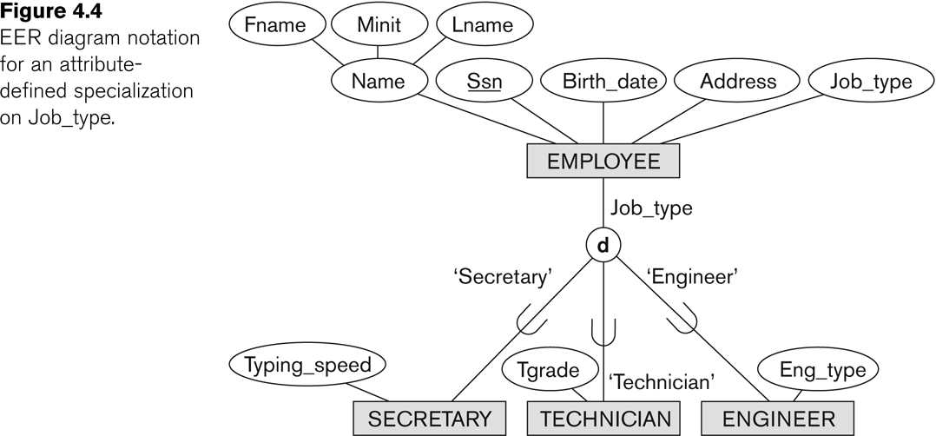
Representing Specialization in EER Diagrams
Slide 4- 9
Notes:
9

Slide 10
Attribute Inheritance in Superclass / Subclass Relationships
An entity that is member of a subclass inherits
All attributes of the entity as a member of the superclass
All relationships of the entity as a member of the superclass
Example:
In the previous slide, SECRETARY (as well as TECHNICIAN and ENGINEER) inherit the attributes Name, SSN, …, from EMPLOYEE
Every SECRETARY entity will have values for the inherited attributes
Slide 4- 10
Notes:
10

Slide 11
Specialization (1)
Specialization is the process of defining a set of subclasses of a superclass
The set of subclasses is based upon some distinguishing characteristics of the entities in the superclass
Example: {SECRETARY, ENGINEER, TECHNICIAN} is a specialization of EMPLOYEE based upon job type.
May have several specializations of the same superclass
Slide 4- 11
Notes:
11

Slide 12
Specialization (2)
Example: Another specialization of EMPLOYEE based on method of pay is {SALARIED_EMPLOYEE, HOURLY_EMPLOYEE}.
Superclass/subclass relationships and specialization can be diagrammatically represented in EER diagrams
Attributes of a subclass are called specific or local attributes.
For example, the attribute TypingSpeed of SECRETARY
The subclass can also participate in specific relationship types.
For example, a relationship BELONGS_TO of HOURLY_EMPLOYEE
Slide 4- 12
Notes:
12

Slide 13
Specialization (3)
Slide 4- 13
Notes:
13

Slide 14
Generalization
Generalization is the reverse of the specialization process
Several classes with common features are generalized into a superclass;
original classes become its subclasses
Example: CAR, TRUCK generalized into VEHICLE;
both CAR, TRUCK become subclasses of the superclass VEHICLE.
We can view {CAR, TRUCK} as a specialization of VEHICLE
Alternatively, we can view VEHICLE as a generalization of CAR and TRUCK
Slide 4- 14
Notes:
14

Slide 15
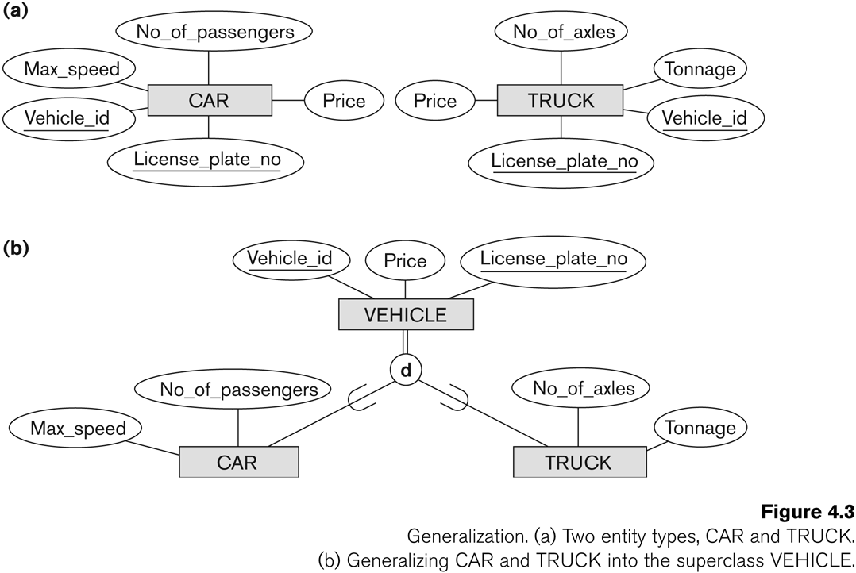
Generalization (2)
Slide 4- 15
Notes:
15

Slide 16
Generalization and Specialization (1)
Diagrammatic notation are sometimes used to distinguish between generalization and specialization
Arrow pointing to the generalized superclass represents a generalization
Arrows pointing to the specialized subclasses represent a specialization
We do not use this notation because it is often subjective as to which process is more appropriate for a particular situation
We advocate not drawing any arrows
Slide 4- 16
Notes:
16

Slide 17
Generalization and Specialization (2)
Data Modeling with Specialization and Generalization
A superclass or subclass represents a collection (or set or grouping) of entities
It also represents a particular type of entity
Shown in rectangles in EER diagrams (as are entity types)
We can call all entity types (and their corresponding collections) classes, whether they are entity types, superclasses, or subclasses
Slide 4- 17
Notes:
17

Slide 18
Constraints on Specialization and Generalization (1)
If we can determine exactly those entities that will become members of each subclass by a condition, the subclasses are called predicate-defined (or condition-defined) subclasses
Condition is a constraint that determines subclass members
Display a predicate-defined subclass by writing the predicate condition next to the line attaching the subclass to its superclass
Slide 4- 18
Notes:
18

Slide 19
Constraints on Specialization and Generalization (2)
If all subclasses in a specialization have membership condition on same attribute of the superclass, specialization is called an attribute-defined specialization
Attribute is called the defining attribute of the specialization
Example: JobType is the defining attribute of the specialization {SECRETARY, TECHNICIAN, ENGINEER} of EMPLOYEE
If no condition determines membership, the subclass is called user-defined
Membership in a subclass is determined by the database users by applying an operation to add an entity to the subclass
Membership in the subclass is specified individually for each entity in the superclass by the user
Slide 4- 19
Notes:
19

Slide 20
Displaying an attribute-defined specialization in EER diagrams
Slide 4- 20

Slide 21
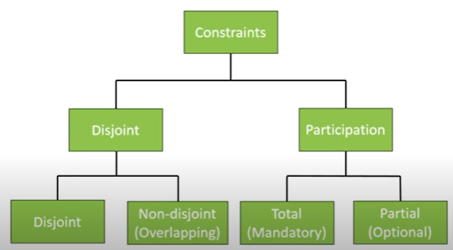
Constraints on Specialization and Generalization (3)
Two basic constraints can apply to a specialization/generalization:
Disjointness Constraint:
Completeness/participation Constraint:
Attribute Constraints:
Slide 4- 21
Notes:
21

Slide 22
Constraints on Specialization and Generalization (4)
Disjointness Constraint:
Specifies that the subclasses of the specialization must be disjoint:
an entity can be a member of at most one of the subclasses of the specialization
Specified by d in EER diagram
If not disjoint, specialization is overlapping:
that is the same entity may be a member of more than one subclass of the specialization
Specified by o in EER diagram
Slide 4- 22
Notes:
22

Slide 23
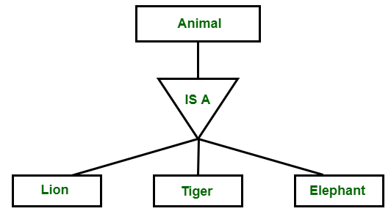
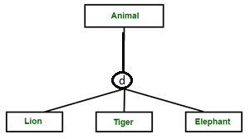
Disjoint Constraint
It specifies that the subclasses of the specialization must be disjoint.
This means that an entity can be a member of at most one of the
subclasses of the specialization. It is denoted by ‘d’ in circle.
In the diagram Employee can be either Secretary or Technician or Engineer

Slide 24
Constraints on Specialization and Generalization (5)
Completeness Constraint:
Total specifies that every entity in the superclass must be a member of some subclass in the specialization/generalization
Shown in EER diagrams by a double line
Partial allows an entity not to belong to any of the subclasses
Shown in EER diagrams by a single line
Slide 4- 24
Notes:
24

Slide 25
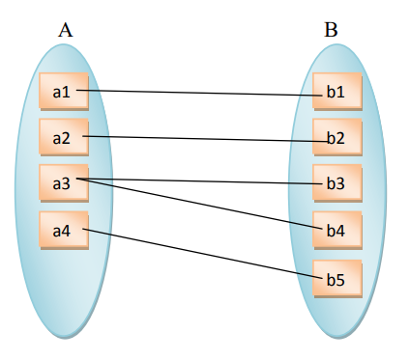
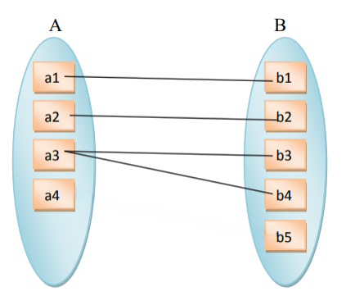
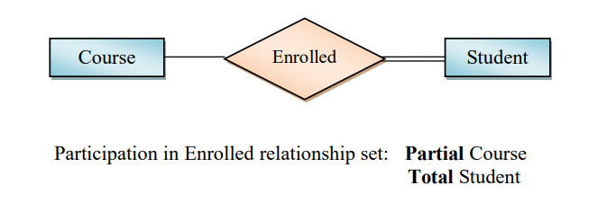
Total participation Partial Participation

Slide 26
Constraints on Specialization and Generalization (6)
Hence, we have four types of specialization/generalization:
Disjoint, total
Disjoint, partial
Overlapping, total
Overlapping, partial
Note: Generalization usually is total because the superclass is derived from the subclasses.
Slide 4- 26
Notes:
26

Slide 27
Example of disjoint partial Specialization
Slide 4- 27
Notes:
27

Slide 28
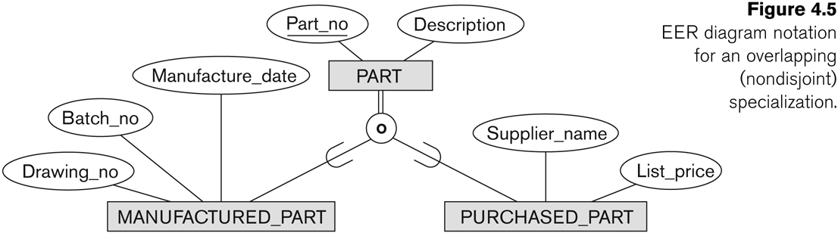
Example of overlapping total Specialization
Slide 4- 28
Notes:
28

Slide 29
Specialization/Generalization Hierarchies, Lattices & Shared Subclasses (1)
A subclass may itself have further subclasses specified on it
forms a hierarchy or a lattice
Hierarchy has a constraint that every subclass has only one superclass (called single inheritance); this is basically a tree structure
In a lattice, a subclass can be subclass of more than one superclass (called multiple inheritance)
Slide 4- 29
Notes:
29

Slide 30
Specialization/Generalization Hierarchies, Lattices & Shared Subclasses (2)
In a lattice or hierarchy, a subclass inherits attributes not only of its direct superclass, but also of all its predecessor superclasses
A subclass with more than one superclass is called a shared subclass (multiple inheritance)
Can have:
specialization hierarchies or lattices, or
generalization hierarchies or lattices,
depending on how they were derived
We just use specialization (to stand for the end result of either specialization or generalization)
Slide 4- 30
Notes:
30

Slide 31
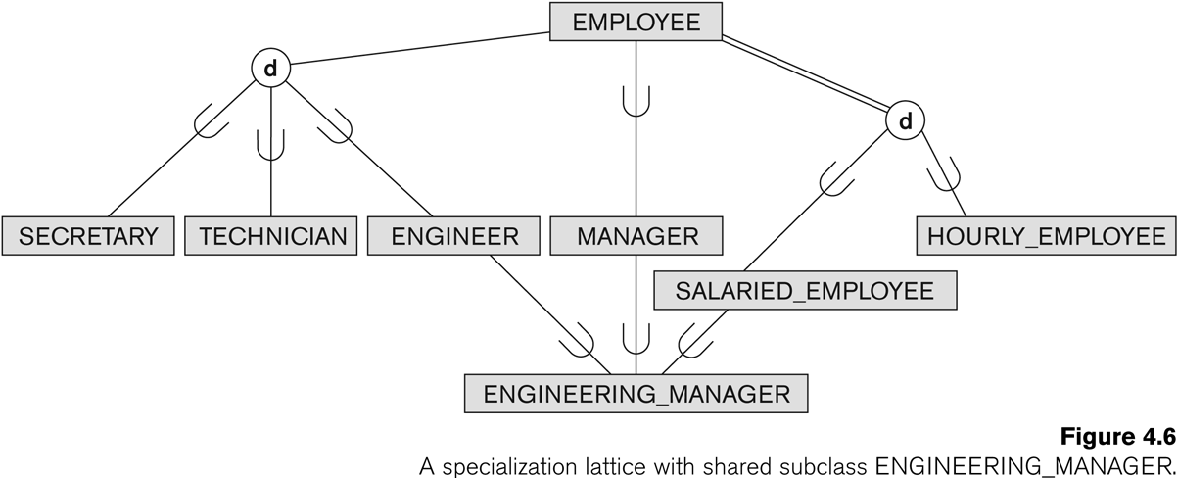
Shared Subclass “Engineering_Manager”
Slide 4- 31
Notes:
31

Slide 32
Specialization/Generalization Hierarchies, Lattices & Shared Subclasses (3)
In specialization, start with an entity type and then define subclasses of the entity type by successive specialization
called a top down conceptual refinement process
In generalization, start with many entity types and generalize those that have common properties
Called a bottom up conceptual synthesis process
In practice, a combination of both processes is usually employed
Slide 4- 32
Notes:
32

Slide 33
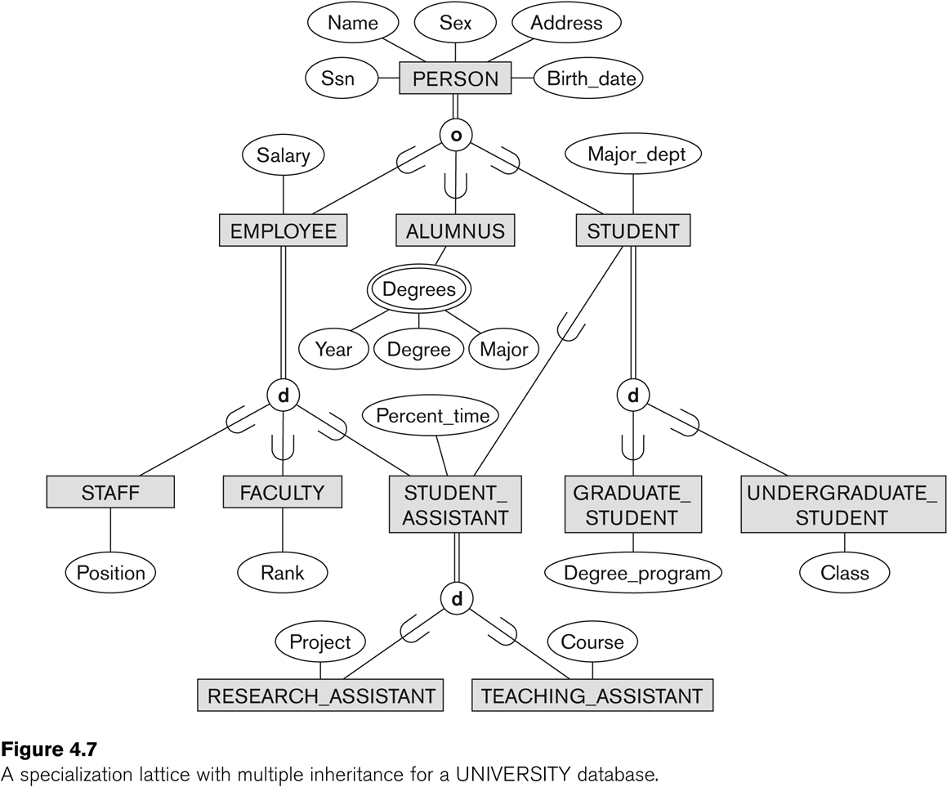
Specialization / Generalization Lattice Example (UNIVERSITY)
Slide 4- 33
Notes:
33

Slide 34
Categories (UNION TYPES) (1)
All of the superclass/subclass relationships we have seen thus far have a single superclass
A shared subclass is a subclass in:
more than one distinct superclass/subclass relationships
each relationships has a single superclass
shared subclass leads to multiple inheritance
In some cases, we need to model a single superclass/subclass relationship with more than one superclass
Superclasses can represent different entity types
Such a subclass is called a category or UNION TYPE
Slide 4- 34
Notes:
34

Slide 35
Categories (UNION TYPES) (2)
Example: In a database for vehicle registration, a vehicle owner can be a PERSON, a BANK (holding a lien on a vehicle) or a COMPANY.
A category (UNION type) called OWNER is created to represent a subset of the union of the three superclasses COMPANY, BANK, and PERSON
A category member must exist in at least one of its superclasses
Difference from shared subclass, which is a:
subset of the intersection of its superclasses
shared subclass member must exist in all of its superclasses
The specialization is neither disjoint nor overlapping—it’s a union.
Slide 4- 35
Notes:
35

Slide 36
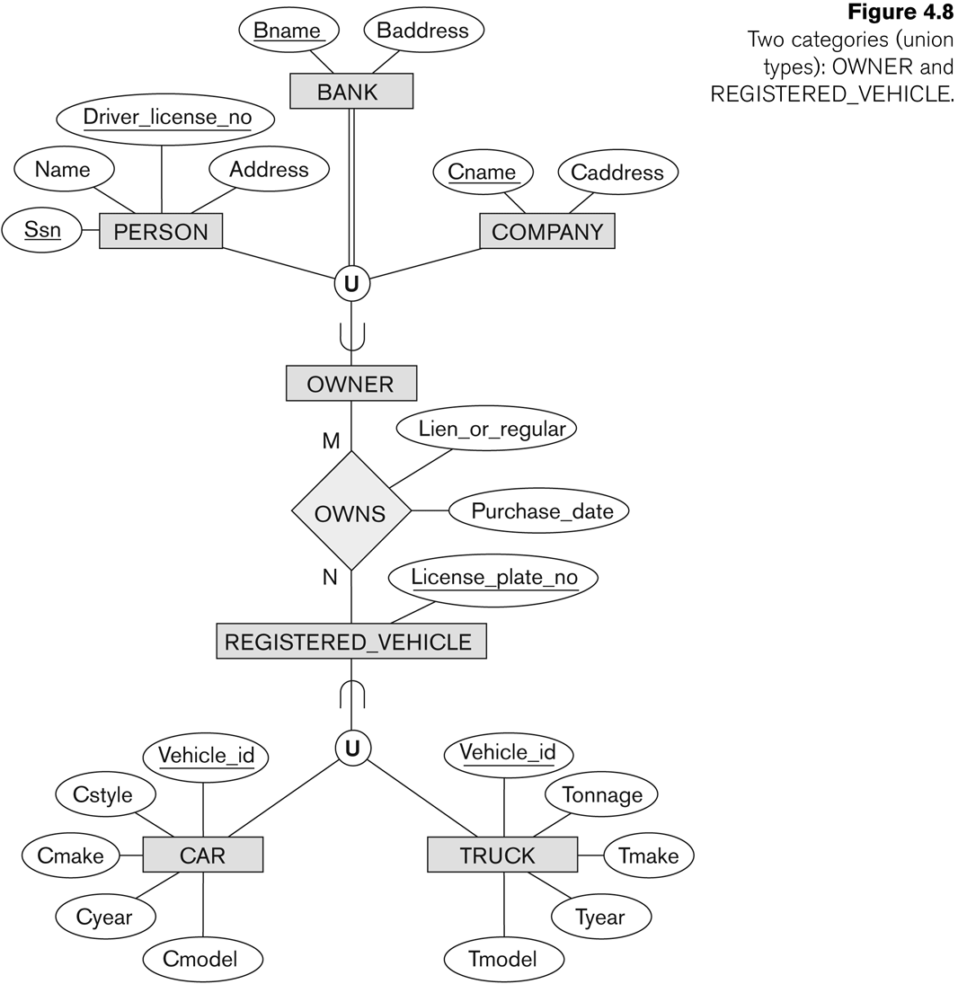
Two categories (UNION types): OWNER, REGISTERED_VEHICLE
Slide 4- 36
Notes:
36

Slide 37
Formal Definitions of EER Model (1)
Class C:
A type of entity with a corresponding set of entities:
could be entity type, subclass, superclass, or category
Note: The definition of relationship type in ER/EER should have 'entity type' replaced with 'class‘ to allow relationships among classes in general
Subclass S is a class whose:
Type inherits all the attributes and relationship of a class C
Set of entities must always be a subset of the set of entities of the other class C
S ⊆ C
C is called the superclass of S
A superclass/subclass relationship exists between S and C
Slide 4- 37
Notes:
37

Slide 38
Formal Definitions of EER Model (2)
Specialization Z: Z = {S1, S2,…, Sn} is a set of subclasses with same superclass G; hence, G/Si is a superclass relationship for i = 1, …., n.
G is called a generalization of the subclasses {S1, S2,…, Sn}
Z is total if we always have:
S1 ∪ S2 ∪ … ∪ Sn = G;
Otherwise, Z is partial.
Z is disjoint if we always have:
Si ∩ Sj empty-set for i ≠ j;
Otherwise, Z is overlapping.
Slide 4- 38
Notes:
38

Slide 39
Formal Definitions of EER Model (3)
A subclass not defined by a predicate is called user-defined .
User-defined specialization is a type of specialization in which the membership of an entity in a subclass is determined by a rule or condition specified by the user.
Superclass (G):
The higher-level entity set that is being specialized into multiple subclasses.
Subclasses (Si​ ):
The lower-level entity sets that represent specialized versions of the superclass.
User-Defined Rules:
The conditions used to define membership in each subclass.
These rules can be complex and involve multiple attributes, derived attributes, or external computations.
Disjoint or Overlapping:
Slide 4- 39
Notes:
39

Slide 40
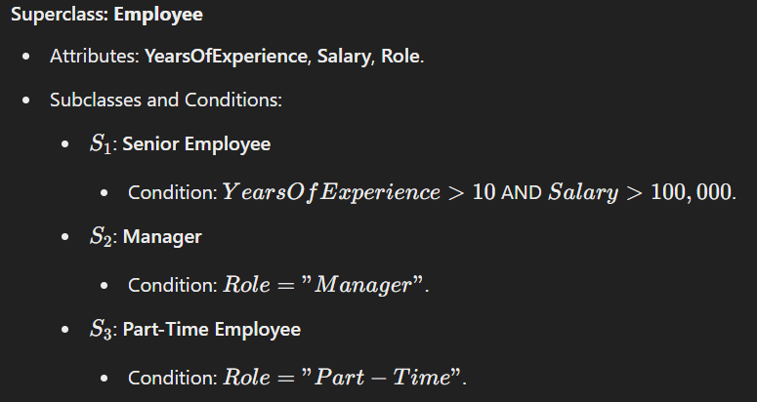
Example

Slide 41
Attribute-defined specialization
Superclass (G):
The higher-level entity set that is being specialized into multiple subclasses.
Subclasses (Si​ ):
The lower-level entity sets that represent specialized versions of the superclass.
Defining Attribute (A):
A single attribute of the superclass G whose value determines the membership of an entity in a particular subclass.
Predicate (𝐴=𝑐𝑖):
A condition or rule used to define membership in each subclass,
where 𝑐𝑖 is a constant value from the domain of the attribute A.

Slide 42
Example: 𝐴="𝑇𝑒𝑎𝑐ℎ𝑒𝑟“, 𝐴="𝐷𝑜𝑐𝑡𝑜𝑟".
Disjoint Condition (if applicable):
If 𝑐𝑖≠𝑐𝑗 for 𝑖≠𝑗, and
A is a single-valued attribute, the specialization is disjoint, meaning an entity can belong to only one subclass.

Slide 43
Alternative diagrammatic notations
ER/EER diagrams are a specific notation for displaying the concepts of the model diagrammatically
DB design tools use many alternative notations for the same or similar concepts
One popular alternative notation uses UML class diagrams
see next slides for UML class diagrams and other alternative notations
Slide 4- 43

Slide 44
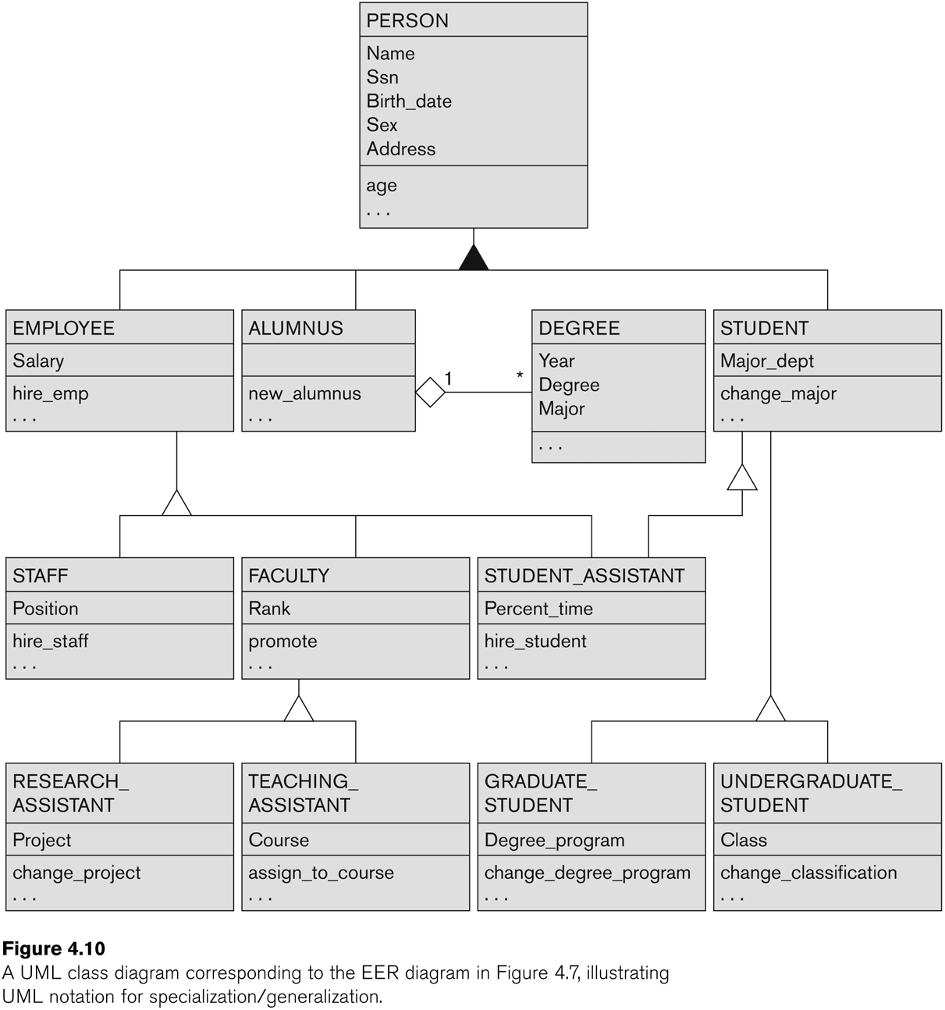
UML Example for Displaying Specialization / Generalization
Slide 4- 44
Notes:
44

Slide 45
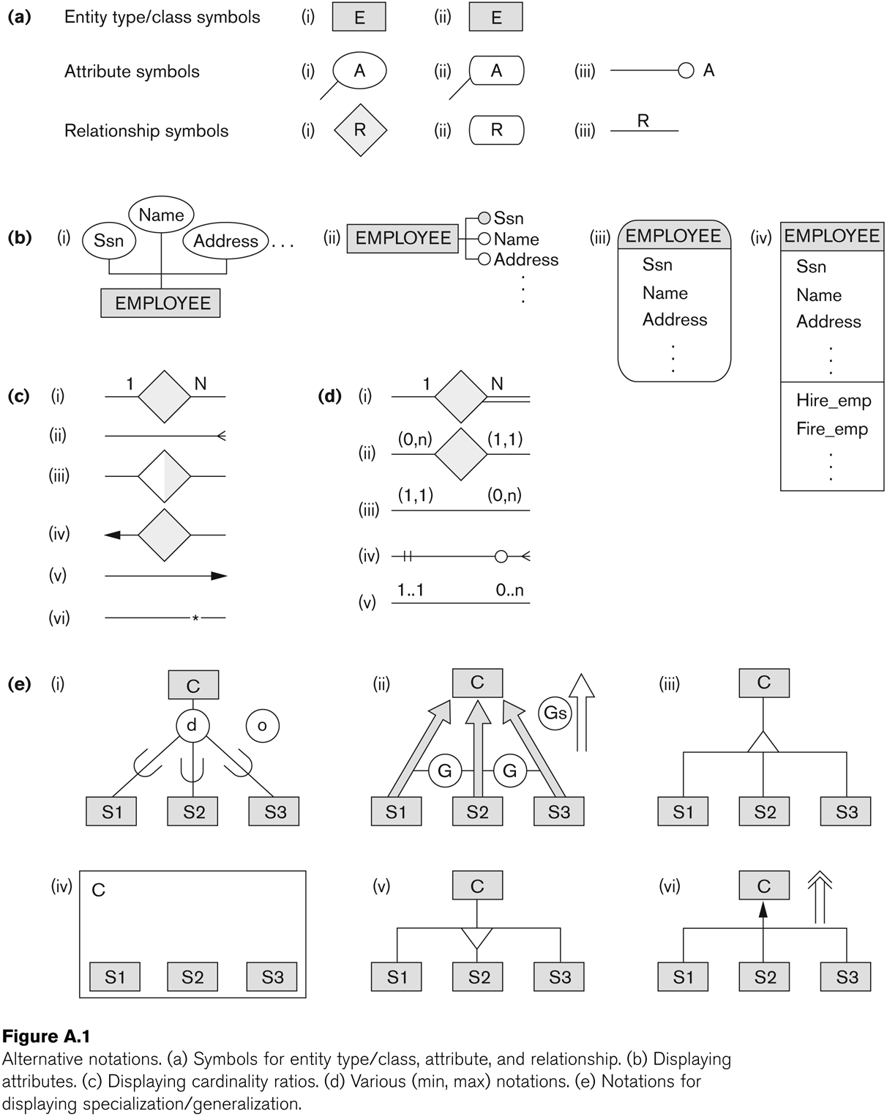
Alternative Diagrammatic Notations
Slide 4- 45
Notes:
45

Slide 46
General Conceptual Modeling Concepts
GENERAL DATA ABSTRACTIONS
CLASSIFICATION and INSTANTIATION
AGGREGATION and ASSOCIATION (relationships)
GENERALIZATION and SPECIALIZATION
IDENTIFICATION
CONSTRAINTS
CARDINALITY (Min and Max)
COVERAGE (Total vs. Partial, and Exclusive (disjoint) vs. Overlapping)
Slide 4- 46
Notes:
46

Slide 47
Ontologies
Use conceptual modeling and other tools to develop “a specification of a conceptualization”
Specification refers to the language and vocabulary (data model concepts) used
Conceptualization refers to the description (schema) of the concepts of a particular field of knowledge and the relationships among these concepts
Many medical, scientific, and engineering ontologies are being developed as a means of standardizing concepts and terminology
Slide 4- 47

Slide 48
Summary
Introduced the EER model concepts
Class/subclass relationships
Specialization and generalization
Inheritance
EER diagrams and alternative notations were presented
Slide 4- 48

